Slide 1
Data Visualization
with Python

Slide 2
Data Visualization with Python
Learning Objectives:
By the end of this lesson, learners will be able to:
Define Matplotlib.
Describe Matplotlib Pyplot and Plotting.
Create charts with Python, Matplotlib Pyplot, and Plotting libraries.

Slide 3
Table of Contents
Data visualisation
Overview of Matplotlib
Installing Matplotlib
Overview of Matplotlib Pyplot and Plotting
Matplotlib Pyplot and Plotting Line Styles
Matplotlib Pyplot Markers
Matplotlib Pyplot Labels, Fonts and Title
Matplotlib Pyplot Subplots
Matplotlib Pyplot - Multiple lines
Matplotlib Pyplot - Scatter
Matplotlib Pyplot - Bars
Matplotlib Bars - Plot color
Matplotlib Bars - Multiple charts
Matplotlib Bars - Stack charts
Introduction to Matplotlib Pie Charts
Start Angle - Matplotlib Pie Charts

Slide 4
Data Visualization
Data visualization means graphical or pictorial representation of the data using graphs and charts, etc. The purpose of plotting data is to visualise variations or show relationships between variables.
Visualization also helps to effectively communicate information to users. For example, traffic symbols, ultrasound reports, books of maps, speedometers, and tuners of instruments are few examples of visualization that we come across daily. Visualization of data is effectively used in fields such as health, finance, science, mathematics, and engineering, etc. In this lesson, we will learn how to visualise data using the Matplotlib library of Python by plotting charts such as line, bar, and scatter, with respect to the various types of data.
“Human visual perception is the “most powerful of data interfaces between computers and humans” — M. McIntyre

Slide 5
Overview of Matplotlib
Matplotlib is a comprehensive library for creating static, animated, and interactive visualizations in Python.
Matplotlib is built on NumPy arrays and is designed to work with the broader SciPy stack.
Matplotlib makes easy things easy, and hard things possible:
Creates publication quality plots.
Makes interactive figures that can zoom, pan, and update.
Customizes visual style and layout.
Exports to many file formats.
Embeds in JupyterLab and Graphical User Interfaces.
Uses a rich array of third-party packages built on Matplotlib.

Slide 6
Installing Matplotlib
For PIP Users:
Users who prefer to use PIP can use the command below to install Matplotlib:
pip install matplotlib
For Conda Users:
Users who prefer to use Conda to install Matplotlib, can use the command below:
conda install matplotlib

Slide 7
Overview of Matplotlib Pyplot and Plotting
Pyplot is a state-based interface to a Matplotlib module, which provides a MATLAB-like interface.
Most of the Matplotlib utilities lie under the pyplot submodule, and are usually imported under the plt alias:
import matplotlib.pyplot as plt
The plot() function is used to draw points (markers) in a diagram.
By default, the plot() function draws a line from point to point.
The function takes parameters for specifying points in the diagram.
Parameter 1 is an array containing the points on the x-axis.
Parameter 2 is an array containing the points on the y-axis.
If we need to plot a line from (1, 3) to (8, 10), we have to pass two arrays [1, 8] and [3, 10] to the plot function.

Slide 8
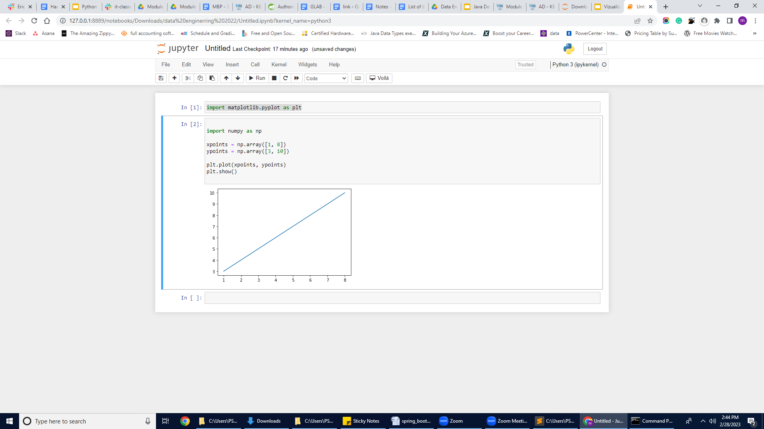
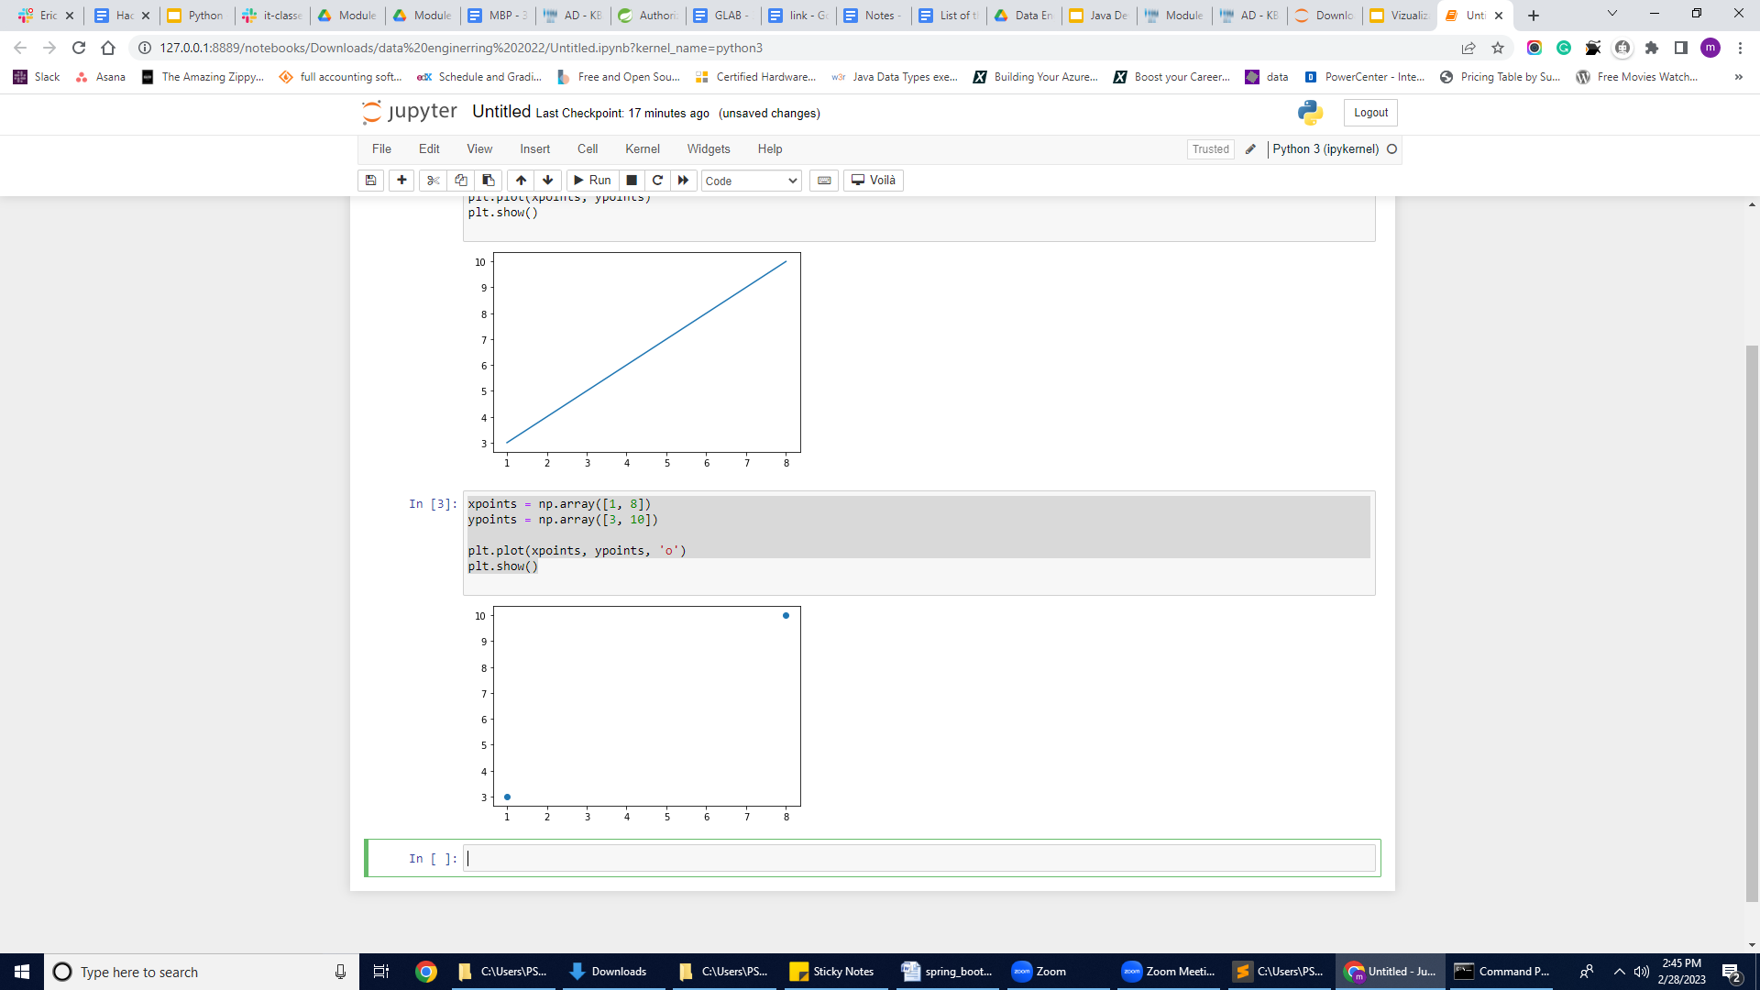
Matplotlib Pyplot and Plotting Example
Example One: With Line
import matplotlib.pyplot as plt
import numpy as np
xpoints = np.array([1, 8])
ypoints = np.array([3, 10])
plt.plot(xpoints, ypoints)
plt.show()
Example Two : Without Line
import matplotlib.pyplot as plt
import numpy as np
xpoints = np.array([1, 8])
ypoints = np.array([3, 10])
plt.plot(xpoints, ypoints, 'o')
plt.show()

Slide 9
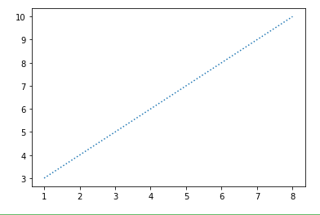
Matplotlib Pyplot and Plotting Line Styles
You can use the keyword argument linestyle, or shorter ls, to change the style of the plotted line:
linestyle can be written as ls.
dotted can be written as :
dashed can be written as --
xpoints = np.array([1, 8])
ypoints = np.array([3, 10])
plt.plot(xpoints, ypoints, linestyle = "dotted")
plt.show()

Slide 10
Matplotlib Pyplot Markers
You can use the keyword argument marker to emphasize each point with a specified marker
Marker Reference: You can choose any of these markers:
Example
'o' Circle
'*' Star
'.' Point
',' Pixel
'x' X
'X' X (filled)
'+' Plus
'P' Plus (filled)
's' Square
'D' Diamond
'd' Diamond (thin)
'p' Pentagon
'H' Hexagon
'h' Hexagon
'v' Triangle Down
'^' Triangle Up
'<' Triangle Left
'>' Triangle Right
'1' Tri Down
'2' Tri Up
'3' Tri Left
'4' Tri Right
'|' Vline
'_' Hline
Mark each point with a circle:
import matplotlib.pyplot as plt
import numpy as np
ypoints = np.array([3, 8, 1, 10])
plt.plot(ypoints, marker = '*')
plt.show()

Slide 11
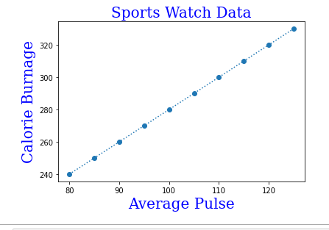
Matplotlib Pyplot Labels, Fonts, and Title
With Pyplot, you can use the xlabel() and ylabel() functions to set a label for the x- and y-axis.
With Pyplot, you can use the title() function to set a title for the plot.
With Pyplot, you can use the fontdict parameter in xlabel(), ylabel(), and title() to set font properties for the title and labels.
Example:
import numpy as np
import matplotlib.pyplot as plt
x = np.array([80, 85, 90, 95, 100, 105, 110, 115, 120, 125])
y = np.array([240, 250, 260, 270, 280, 290, 300, 310, 320, 330])
font1 = {'family':'serif','color':'blue','size':20}
font2 = {'family':'serif','color':'darkred','size':15}
plt.plot(x, y, 'o',linestyle='dotted')
plt.title("Sports Watch Data", fontdict = font1)
plt.xlabel("Average Pulse", fontdict = font1)
plt.ylabel("Calorie Burnage", fontdict = font1)
plt.show()

Slide 12
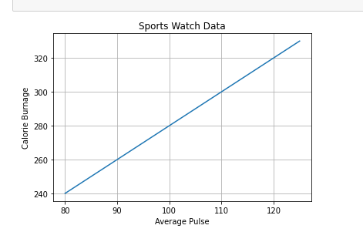
Matplotlib Pyplot Adding Grid Lines
With Pyplot, you can use the grid() function to add grid lines to the plot.
import numpy as np
import matplotlib.pyplot as plt
x = np.array([80, 85, 90, 95, 100, 105, 110, 115, 120, 125])
y = np.array([240, 250, 260, 270, 280, 290, 300, 310, 320, 330])
plt.title("Sports Watch Data")
plt.xlabel("Average Pulse")
plt.ylabel("Calorie Burnage")
plt.plot(x, y)
plt.grid()
plt.show()

Slide 13
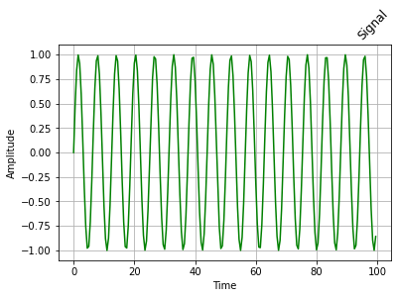
Example:
# assigning time values of the signal
# initial time period, final time period and phase angle
signalTime = np.arange(0, 100, 0.5);
# getting the amplitude of the signal
signalAmplitude = np.sin(signalTime)
# depicting the visualization
plt.plot(signalTime, signalAmplitude, color ='green')
plt.xlabel('Time')
plt.ylabel('Amplitude')
plt.grid()
# displaying the title
plt.title("Signal",
loc='right',
rotation=45)
Result:
Notes:
Here, the label argument is assigned to ‘signal’ , loc argument is assigned to ‘right’ and the rotation argument (**kwargs) which takes angle value in degree is assigned to 45 degrees.

Slide 14
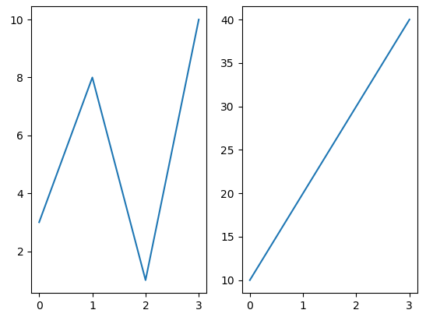
Matplotlib Pyplot Subplots
Display Multiple Plots: With the subplot() function, you can draw multiple plots in one figure.
The subplot() function returns the axes object at a given grid position. The signature of this function is −.
plt.subplot(subplot(nrows, ncols, index)
import matplotlib.pyplot as plt
import numpy as np
#plot 1:
x = np.array([0, 1, 2, 3])
y = np.array([3, 8, 1, 10])
plt.subplot(1, 2, 1)
plt.plot(x,y)
#plot 2:
x = np.array([0, 1, 2, 3])
y = np.array([10, 20, 30, 40])
plt.subplot(1, 2, 2)
plt.plot(x,y)
plt.show()

Slide 15
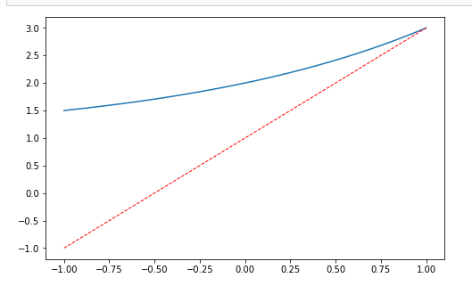
Matplotlib Pyplot - Multiple lines
More than one line can be in the plot. To add another line, just call the plot(x,y) function again. In the example below, we have two different values for y (y1,y2) that are plotted onto the chart.
import matplotlib.pyplot as plt
import numpy as np
x = np.linspace(-1, 1, 50)
y1 = 2*x + 1
y2 = 2**x + 1
plt.figure(num = 3, figsize=(8, 5))
plt.plot(x, y2)
plt.plot(x, y1,
color='red',
linewidth=1.0,
linestyle='--'
)
plt.show()

Slide 16
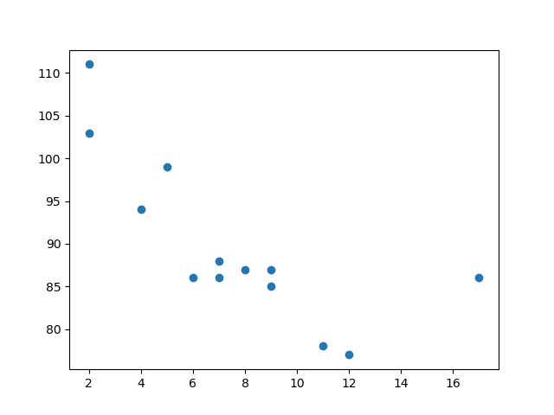
Matplotlib Pyplot - Scatter
With Pyplot, you can use the scatter() function to draw a scatter plot.
The scatter() function plots one dot for each observation. It needs two arrays of the same length, one for the values of the x-axis, and one for values on the y-axis:
import matplotlib.pyplot as plt
import numpy as np
x = np.array([5,7,8,7,2,17,2,9,4,11,12,9,6])
y = np.array([99,86,87,88,111,86,103,87,94,78,77,85,86])
plt.grid()
plt.scatter(x, y)
plt.show()

Slide 17
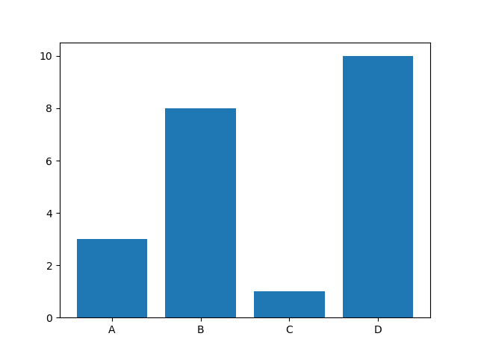
Matplotlib Pyplot - Bars
With Pyplot, you can use the bar() function to draw bar graphs:
import matplotlib.pyplot as plt
import numpy as np
x = np.array(["A", "B", "C", "D"])
y = np.array([3, 8, 1, 10])
plt.bar(x,y)
plt.show()

Slide 18
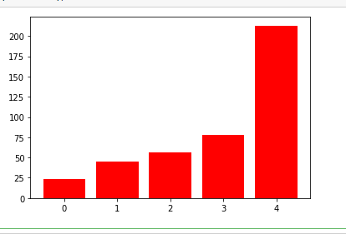
Matplotlib Bars - Plot color
You can change the color of the bar chart. To do that, just add the color parameter.
The parameter can be set to an English color definition like ‘red.
import numpy as np
import pandas as pd
from pandas import DataFrame
import matplotlib.pyplot as plt
data = [23, 45, 56, 78, 213]
plt.bar(range(len(data)), data, color='red')
plt.show()

Slide 19
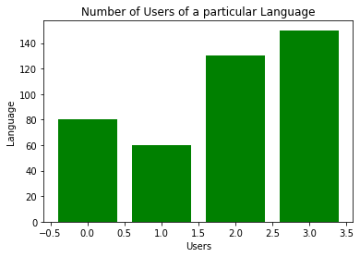
Example: Matplotlib Bars
# assigning x and y coordinates
language = ['C','C++','Java','Python']
users = [80,60,130,150]
# len find the length of language
index = np.arange(len(language))
print(index)
plt.bar(index, users, color='green')
plt.xlabel('Users')
plt.ylabel('Language')
# displaying the title
plt.title(label='Number of Users of a particular Language', fontweight=10)

Slide 20
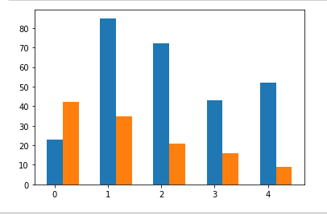
Matplotlib Bars - Multiple charts
Do you need multiple bar charts? You can plot multiple bar charts in one plot.
The code below adds two bar charts by calling the method twice. A width parameter is specified
import numpy as np
import pandas as pd
from pandas import DataFrame
import matplotlib.pyplot as plt
data1 = [23,85, 72, 43, 52]
data2 = [42, 35, 21, 16, 9]
width =0.3
plt.bar(np.arange(len(data1)), data1, width=width)
plt.bar(np.arange(len(data2))+ width, data2, width=width)
plt.show()

Slide 21
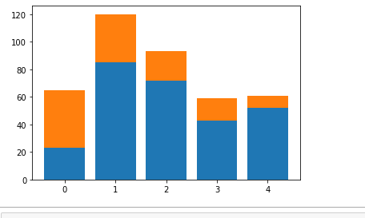
Matplotlib Bars - Stack charts
You can stack bar charts on top of each other, which is particularly useful when your multiple values combine into something greater.
import numpy as np
import pandas as pd
from pandas import DataFrame
import matplotlib.pyplot as plt
data1 = [23,85, 72, 43, 52]
data2 = [42, 35, 21, 16, 9]
plt.bar(range(len(data1)), data1)
plt.bar(range(len(data2)), data2, bottom=data1)
plt.show()

Slide 22
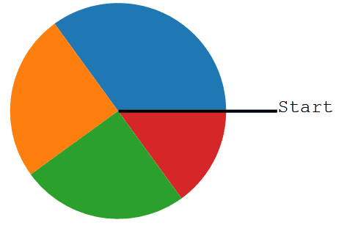
Introduction to Matplotlib Pie Charts
A Pie Chart can only display one series of data. Pie charts show the size of items (called a wedge) in one data series, proportional to the sum of the items. The data points in a pie chart are shown as a percentage of the whole pie.
Matplotlib API has a pie() function that generates a pie diagram representing data in an array.
import matplotlib.pyplot as plt
import numpy as np
y = np.array([35, 25, 25, 15])
plt.pie(y)
plt.show()
As you can see, the pie chart draws one piece (wedge) for each value in the array (in this case [35, 25, 25, 15]).
By default, the plotting of the first wedge starts from the x-axis, and moves counterclockwise.

Slide 23
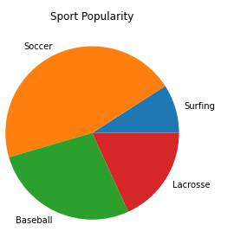
Introduction to Matplotlib Pie Charts (continued)
The pie method takes an x parameter as its first argument, which are the values that will make up the wedges of the pie. They can be given as decimals (percentages of total) or raw values; it doesn't really matter, as Matplotlib will convert them to percentages regardless. The one caveat here is that if the sum(x) < 1, the wedges will not automatically fill in the full pie. We will give an example below.
The labels argument should be an iterable of the same length and order of x that gives labels for each pie wedge.
For our example, let's say we want to show which sports are most popular at a given school by looking at the number of kids that play each sport.
x = [10, 50, 30, 20]
labels = ['Surfing', 'Soccer', 'Baseball', 'Lacrosse']
fig, ax = plt.subplots()
ax.pie(x, labels=labels)
ax.set_title('Sport Popularity')
plt.tight_layout()

Slide 24
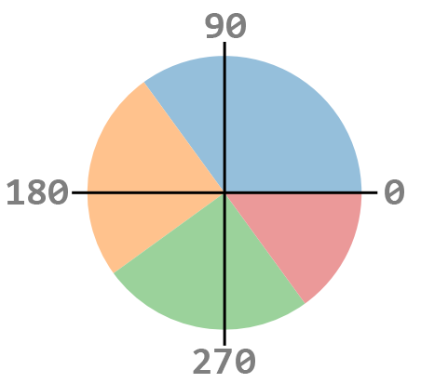
Start Angle - Matplotlib Pie Charts
As mentioned, the default start angle is at the x-axis, but you can change the start angle by specifying a startangle parameter.
The startangle parameter is defined with an angle in degrees, default angle is 0:

Slide 25
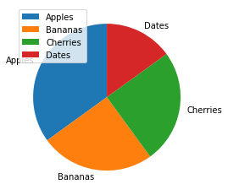
Example - Start Angle - Matplotlib Pie Charts
y = np.array([35, 25, 25, 15])
# label parameter must be an array with one label for each wedge:
mylabels = ["Apples", "Bananas", "Cherries", "Dates"]
plt.pie(y, labels = mylabels, startangle = 90)
plt.legend() # To add a list of explanation for each wedge, use the legend() function:
plt.show()

Slide 26
Knowledge Check
What is Matplotlib?
What are some of the features of Matplotlib?
What are some of the major components of any graph or plot?
Name the function, which is used to save the plot?

Slide 27
Summary
Matplotlib library is used for creating static, animated, and interactive 2D- plots or figures in Python.
In order to be able to use Python’s Data Visualisation library, we need to import the pyplot module from Matplotlib library, using the following statement: import matplotlib.pyplot as plt, where plt is an alias or an alternative name for matplotlib.pyplot. You can keep any alias of your choice.
The pyplot module of matplotlib contains a collection of functions that can be used to work on a plot. The plot() function of the pyplot module is used to create a figure. A figure is the overall window where the outputs of pyplot functions are plotted.
plot() is provided with two parameters, which indicates values for x-axis and y-axis, respectively.
The various components of a plot are: Title, Legend, Ticks, x label, ylabel • plt.plot() is used to build a plot, where plt is an alias. • plt.show() is used to display the figure, where plt is an alias.

